Slide 1
VBA

Slide 2
What is VBA?
VBA is commonly used to automate Excel with macros, add new user defined worksheet functions (UDFs) and react to Excel events
User can create customized function

Slide 3
To turn on Developer
File-> options-> customize ribbon-> developer

Slide 4
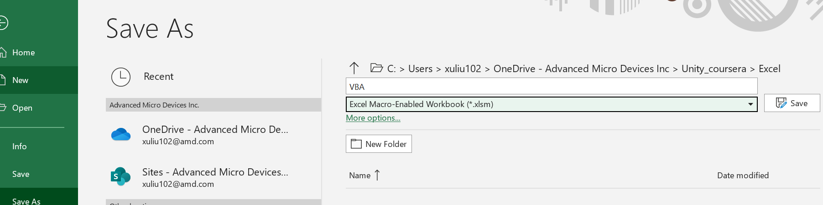
VBA file format

Slide 5
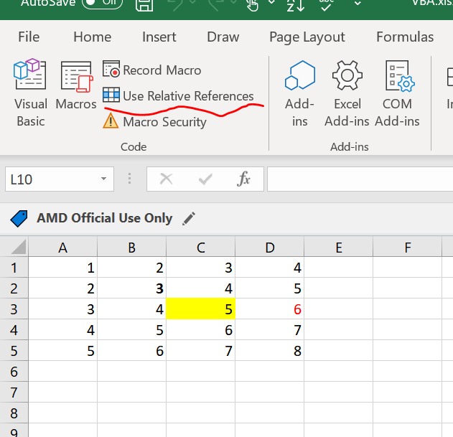
Absolute vs Relative Macro
Click here to enable
To review the code

Slide 6
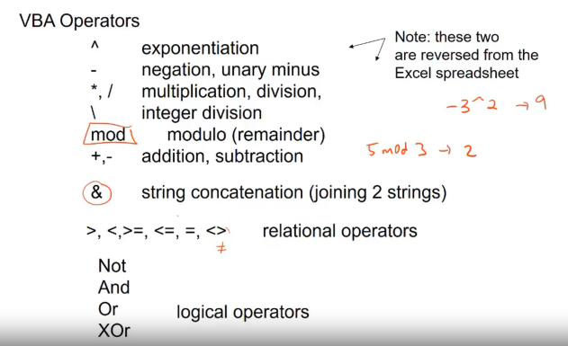
VBA Operators

Slide 7
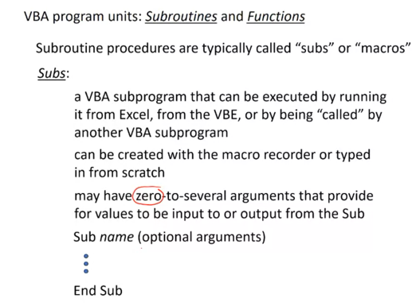
Subroutines and Functions
Example of subroutines:
Most of the cases, user no need to provide any arguments

Slide 8
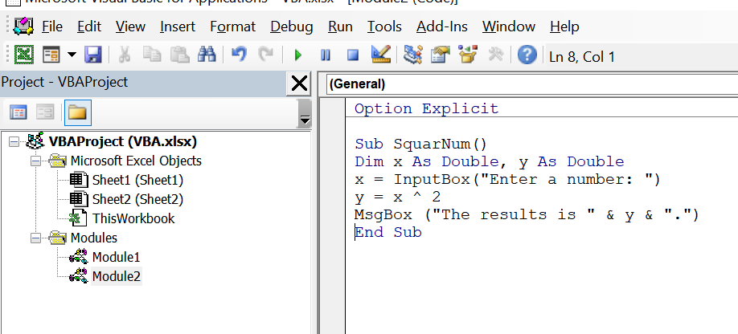
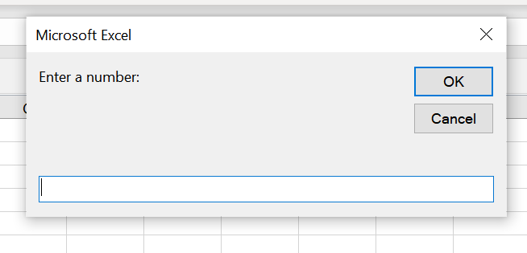
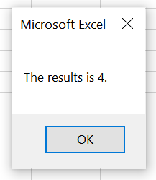
Example of subroutine
To capture any syntax error

Slide 9
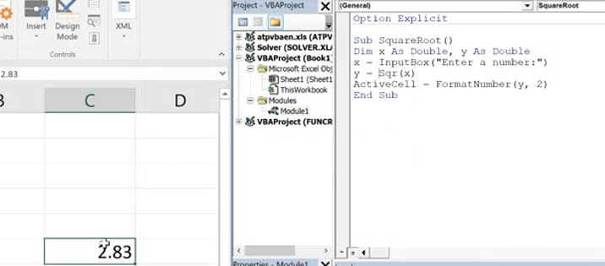
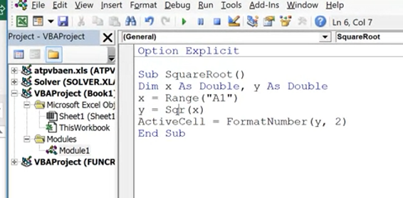
Example of subroutine 1
To print the result in active cell
Take input from A1 cell instead of inputbox

Slide 10
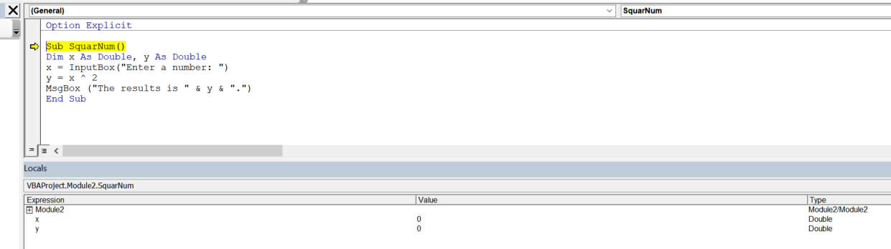
How to troubleshoot subroutine
Press “F8”to step each line

Slide 11
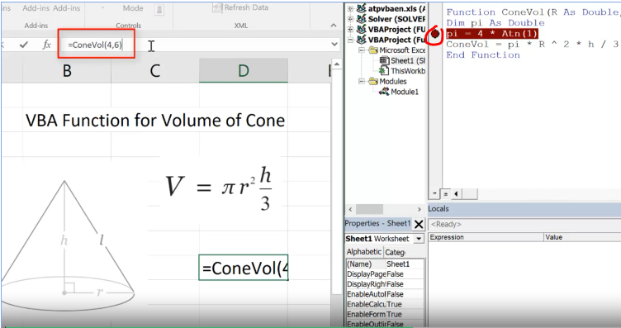
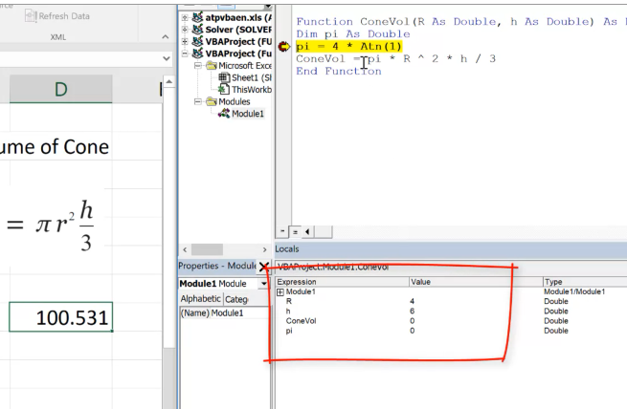
How to troubleshoot function
2) In excel type in the function and press enter
1) Put a break point here
3) Result here

Slide 12
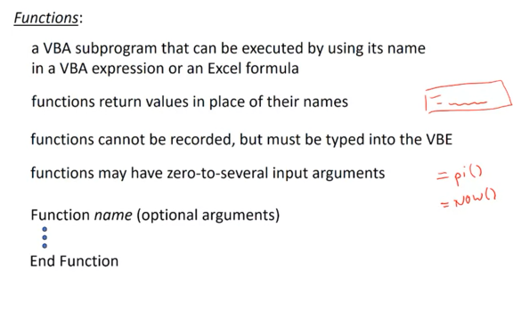
Functions
Most of functions have arguments

Slide 13
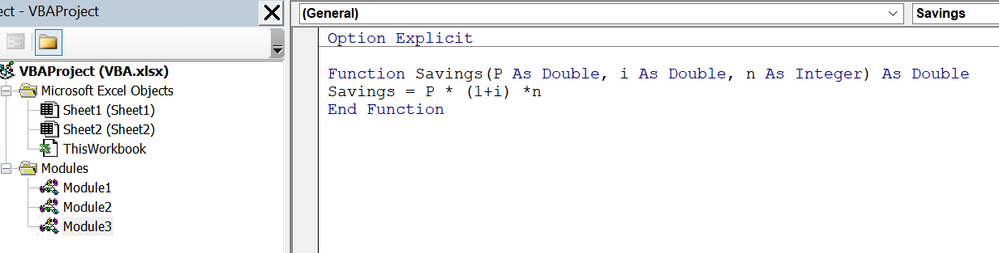
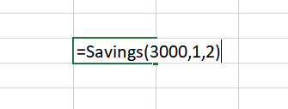
Example of functions
Function output is double
Must be the same name with Functions!

Slide 14
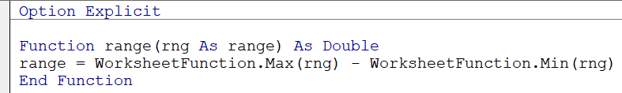
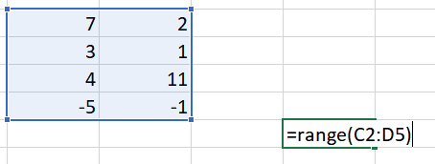
Can borrow excel functions as well…
Excel worksheet function find max over a range of number
Excel worksheet function find min over a range of number

Slide 15
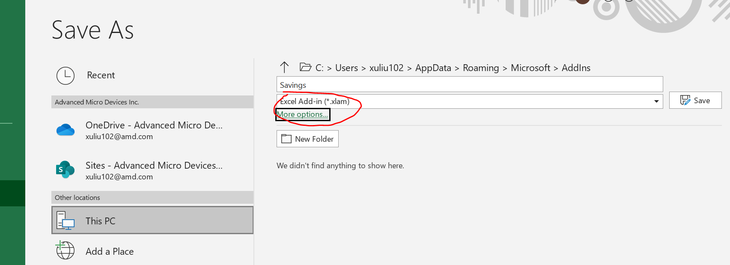
Convert a user-defined function to excel add-in
Save the self defined function to .xlam file format

Slide 16
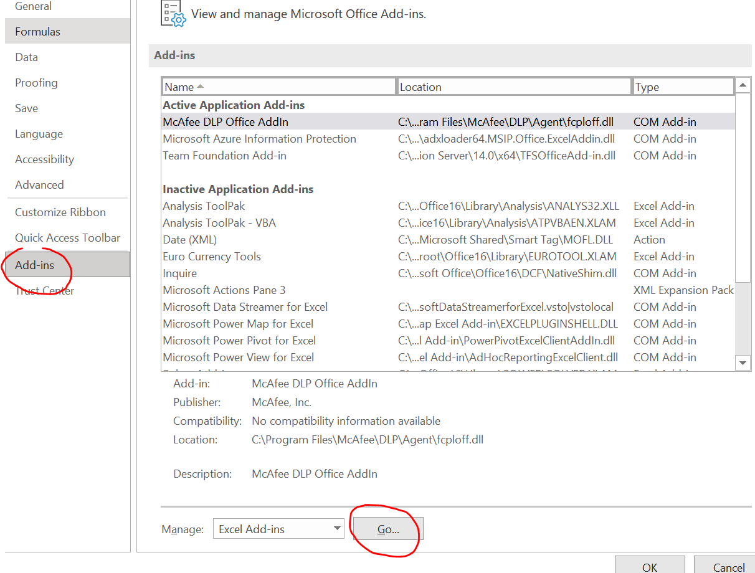
Continue..
If a new workbook wants to use the function, click “file”-> “options”-> “Add-ins” and lick “go” at the bottom and “browse” and find the “xlam” file we saved earlier on

Slide 17
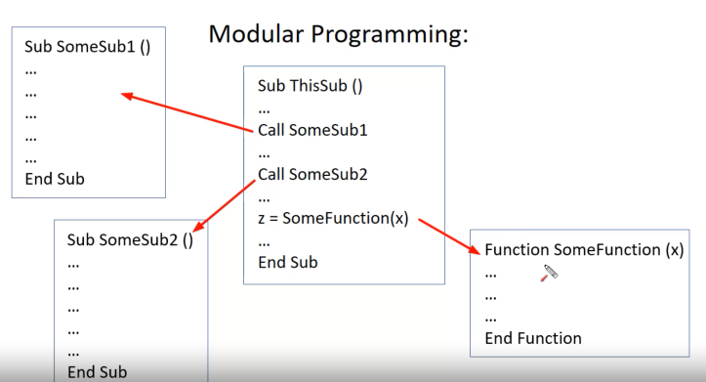
Modular programming

Slide 18
Practical example….

Slide 19
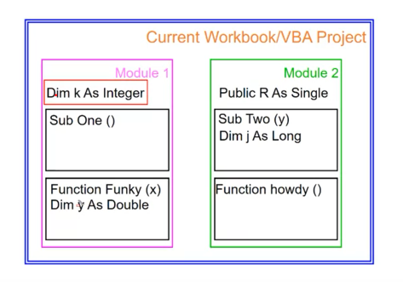
Variable scope
If we declare variable R here, it available for both modules. Workbook level
If we declare variable here, the variable k is available for both “sub one” and “Funky” functions. Modular level
Variable y is only available for “Funky” function

Slide 20
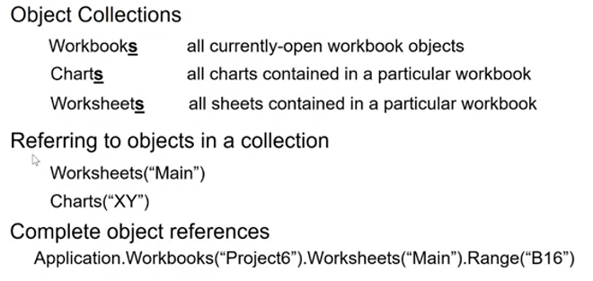
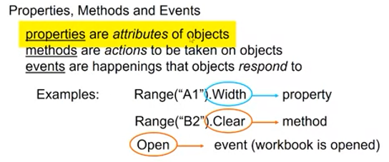
Objects, properties, method and events
Refer workbook ‘project6’ and worksheets “Main”, range B16
Access object’s properties, method and events

Slide 21
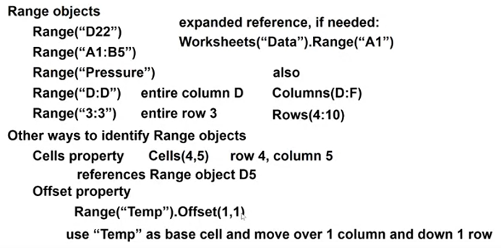
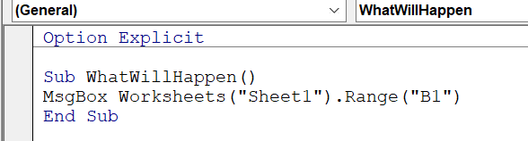
Continue..
Correction “D:F”
Correction “4:10”
Print sheet1, B1 cell data

Slide 22
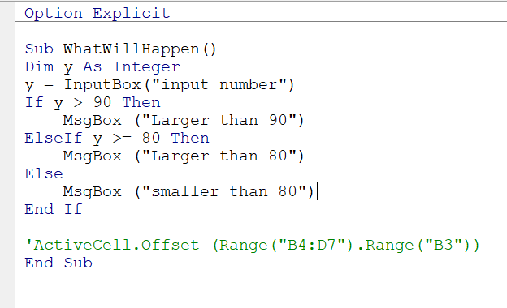
Conditional (if,else) statement

Slide 23
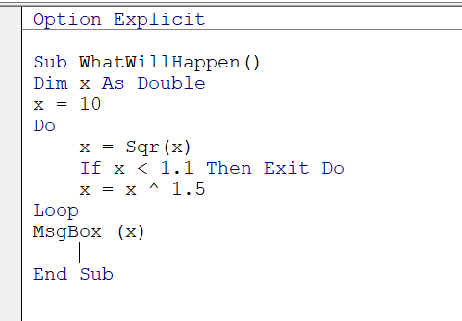
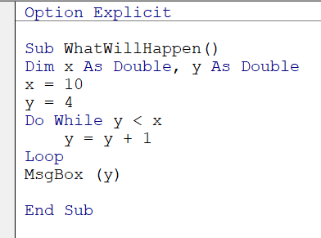
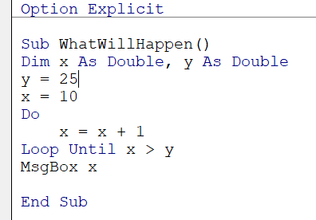
Iteration(Do loop)
Not a pre-defined number of iterations. Interate until some condition is met

Slide 24
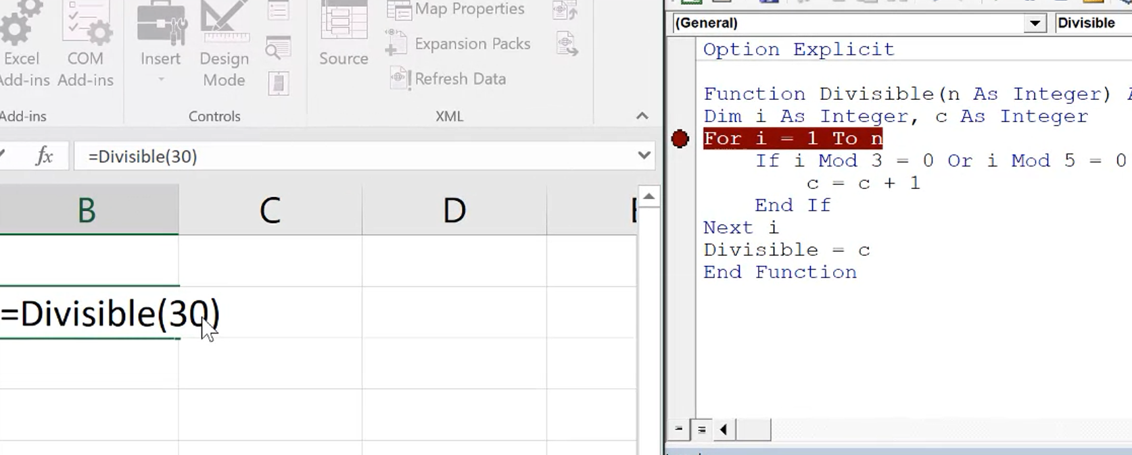
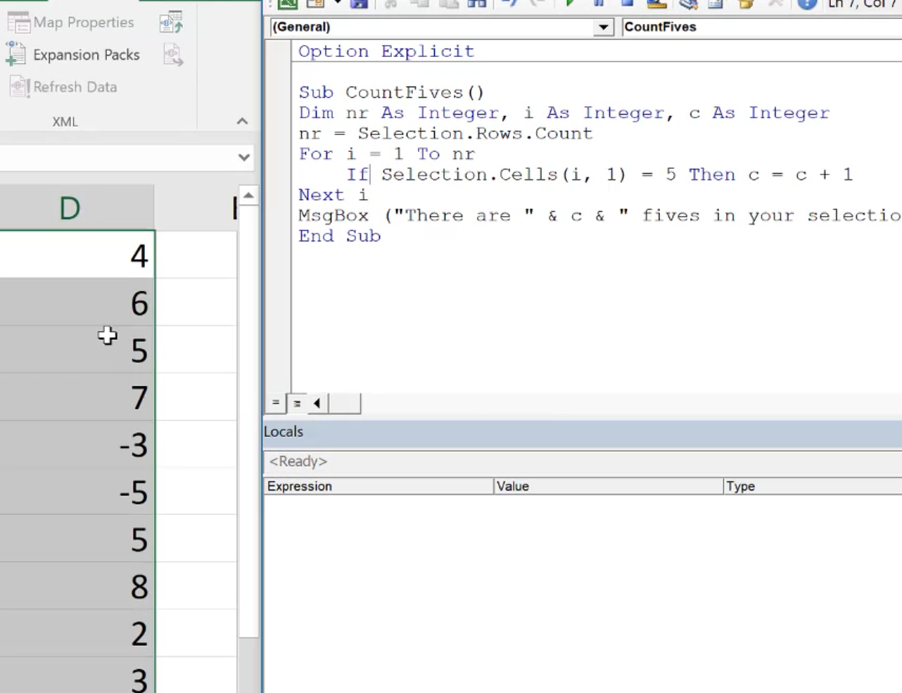
Iteration (For..Next)
A pre-defined number of iterations.
Count how many 5s are there in the selected cells
Count how many numbers can be divided by 3 or 5 (from 1 to 30)

Slide 25
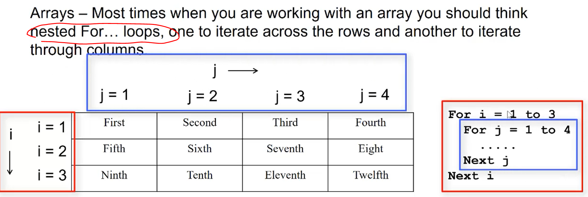
Array vs vector in excel
Array : 2 or more row and or more columns
Vector: either number of row or column is 1

Slide 26
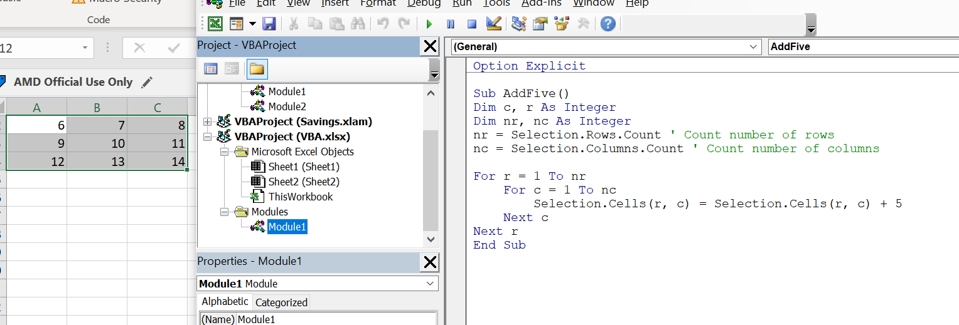
Arrays in VBA
Selected row/col data in excel each element increases by 5

Slide 27
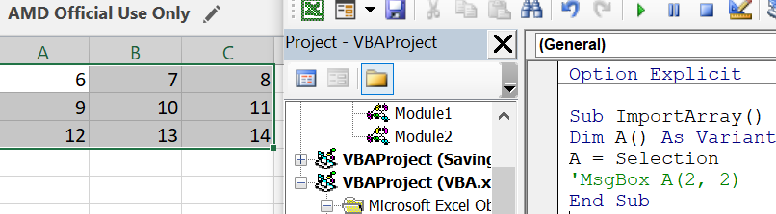
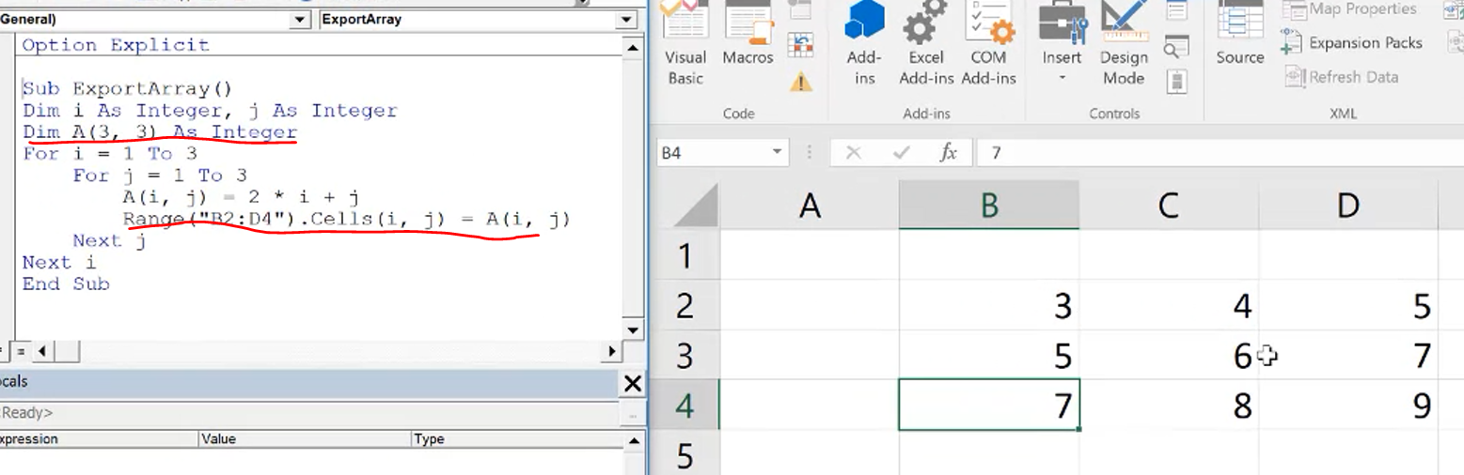
Import excel array to VBA or vice versera
Import array data from excel to VBA
Define VBA local array as a (3,3) array
Export VBA array to excel

Slide 28
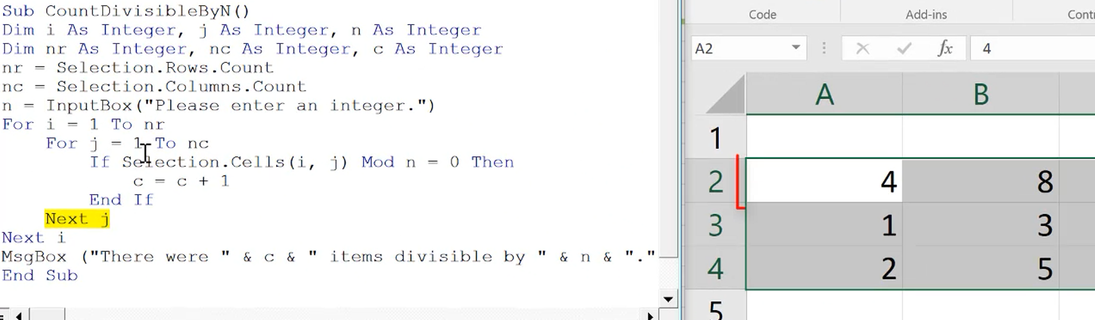
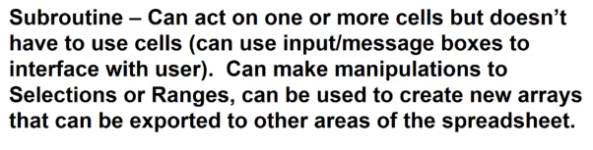
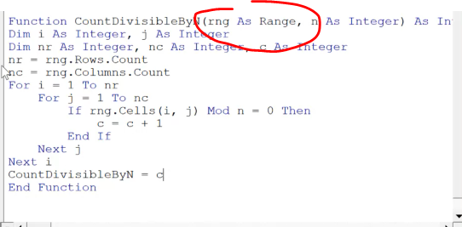
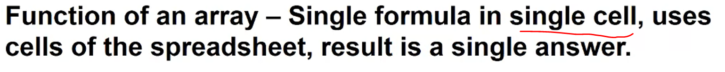
Using arrays in subroutines and functions
Example count how numbers in selected range can be divided by n (user input)
range

Slide 29
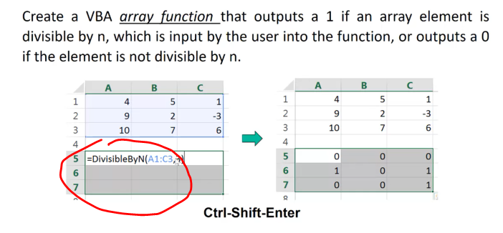
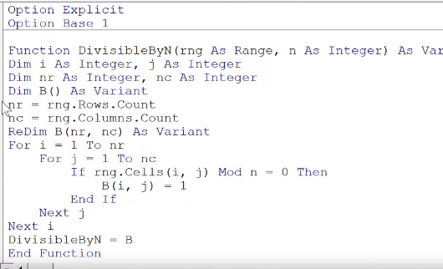
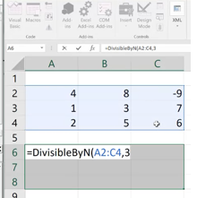
Array function
Highlight these col/rows (instead of tying in single cell) and press “control+shift+enter”
code
Hightlight 3,3 array first and type in function and press “control+shift+enter”

Slide 30
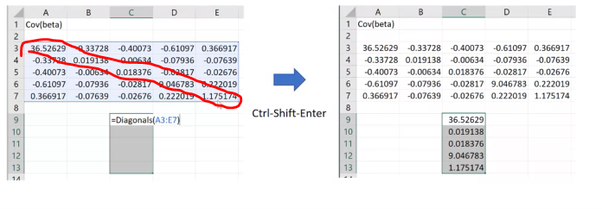
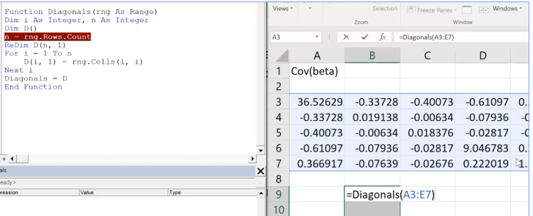
Extract diagonal elements from a square matrix
Extract these data
code

Slide 31
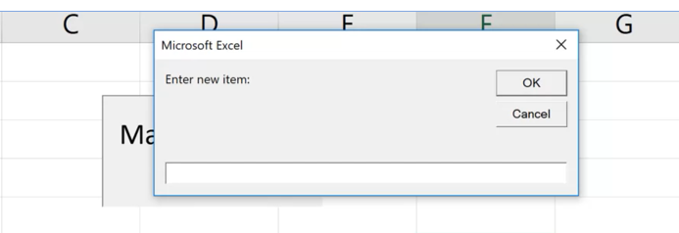
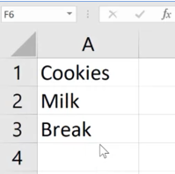
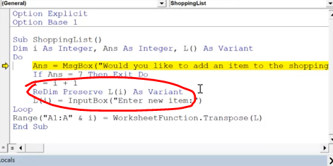
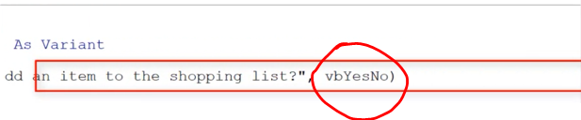
ReDim Preserver
Keep asking user for item until user press “cancel”. The array needs to be dynamic

Slide 32
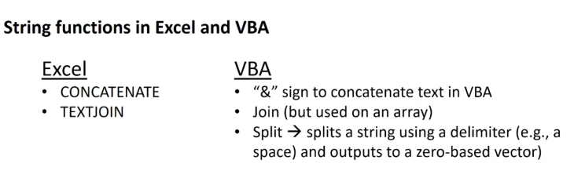
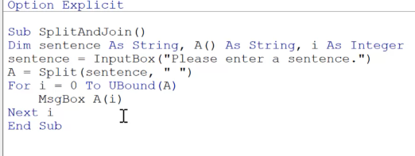
Use string in VBA
A(): unknown sized vector

Slide 33



VBA example of array function for separating strings

Slide 34

Exporting data from excel to .txt file
Export user input information into a text file.

Slide 35

Importing data from .txt files

Slide 36


worksheet

Slide 37

Iteration through worksheet
Put7 into each worksheet cell B2

Slide 38


All about workbooks

Slide 39

Continue…

Slide 40


Advanced input boxes
Inputbox function:
Will show this message “you didn’t enter anything, please try again”

Slide 41

Continue…

Slide 42


Advanced messagebox

Slide 43

Event handlers

Slide 44

User form

Slide 45


User form example
1)
2)
Each one has their name. Remember the name coz we will use it later

Slide 46



3)
4)
5)
Put button
Default “Mul” will be selected if we put value as “True”

Slide 47


6)
7) Update script
Rename it if you want

Slide 48


8) Insert a module
9)

Slide 49



10)
11)
Select “ThisWorkbook”
When workbook open, it will run Runform() which will run the userform1

Slide 50


12) insert a button

Slide 51


13)
Check whether the input value is valid or not. If it’s invalid, show warning message

Slide 52

Combo boxes

Slide 53


Combo box example
1)
2)

